Slide 1
Inventory Store, Move, Relocation and Adjustments
WMS Guide

Slide 2
Table of Contents
Store (Putaway).…......................................................................................................3
Inventory Move.........................................................................................................10
Inventory Relocation.................................................................................................16
Inventory Adjustments.………………………….................................................................21

Slide 3
Store (Putaway)

Slide 4
Store
  This menu allows the storage of a product to a specified location, directed by the mobile device.
  Completion of storage is performed automatically using a mobile device and the system will automatically update inventory records to reflect the new location of the product.

Slide 5
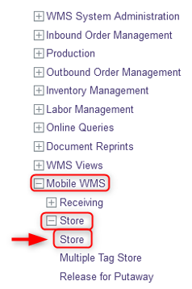
Store
With a mobile device, select the Store resource.
Under the Store resource, click on Store.

Slide 6
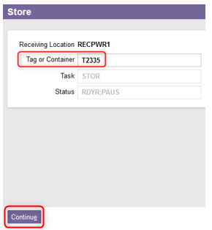
Store
Enter the Tag or Container to be stored.
Click Continue.

Slide 7
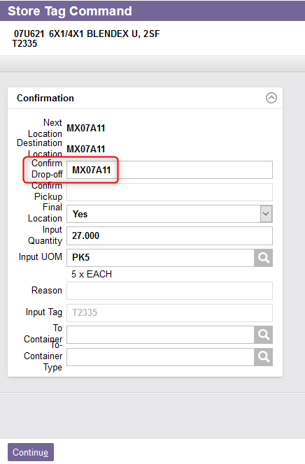
Store
The page of the Store Tag Command view is displayed.
Take the product specified and physically move it to the Next Location.
Confirm the drop-off point.
Note: The final destination is always set to Yes.

Slide 8
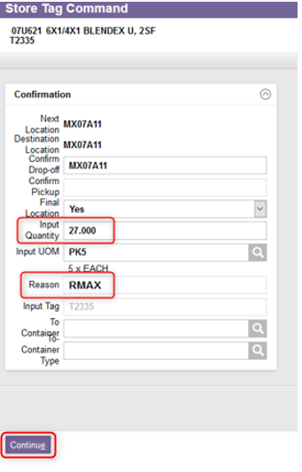
Store
Eventually, change the quantity if, for any reason, it is not possible to store the entire quantity. In such a situation, the remaining quantities will be stored later.
If the quantity has been changed, enter a valid reason code (e.g., RMAX for “Replenishment Quantity Maximization”)
Click Continue.

Slide 9
Store
Once all the store commands have been completed, click Close in the top right corner of the page.
  You have now completed the store process. The system will update inventory records to reflect the new location of the product.

Slide 10
Inventory Move

Slide 11
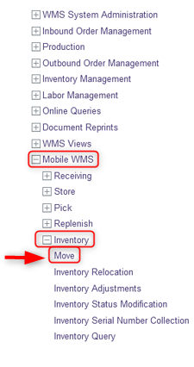
Inventory Move
Inventory Move is used to move inventory from one location to another. This is performed using a mobile device.
With a mobile device, select the Inventory resource.
Under the Inventory resource, click on Move.

Slide 12
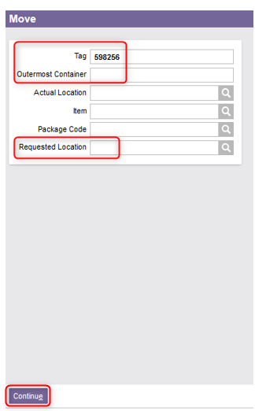
Inventory Move
  Enter the Tag or the Container.
  Usually, the Requested Location is left blank. The location of the product will be thus determined according to the storage rules previously defined. If desired, specify the Requested Location to force the product to be stored in a specific location.
  Click Continue.

Slide 13
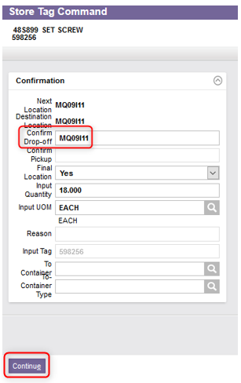
Inventory Move
  Confirm the drop-off point.
  Then, click Continue.

Slide 14
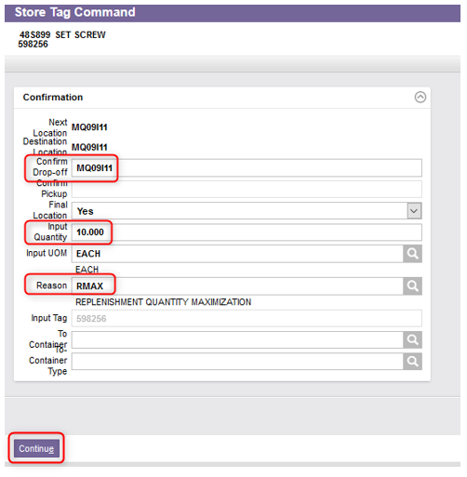
Inventory Move
  Additional note – A partial quantity may be moved. In that case, in the Store Tag Command page:
  Confirm the drop-off point.
  Change the Input Quantity.
  Enter a Reason code,
  And click Continue.

Slide 15
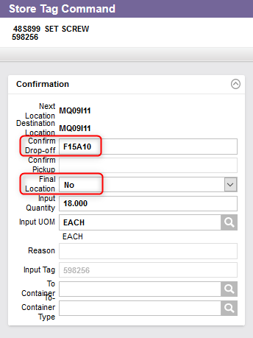


Inventory Move
  Additional note – The destination location can be overridden. In that case, in the Store Tag Command page:
  Confirm the new drop-off point.
  If applicable, change the Final location to No.
  Click Continue.
  A message to confirm will appear:
    Select Yes to confirm this is the final location. The associated queued command will be deleted from the system.
    Select No if this is not the final location. The queued command will be kept in the system.

Slide 16
Inventory Relocation

Slide 17
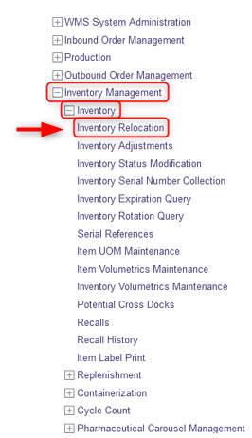
Inventory Relocation
Inventory Relocation is another method of moving inventory from one location to another. This is performed using a desktop computer.
On a desktop computer, select the Inventory Management resource.
Under the Inventory Management resource, click on Inventory.
Under Inventory, select Inventory Relocation.

Slide 18
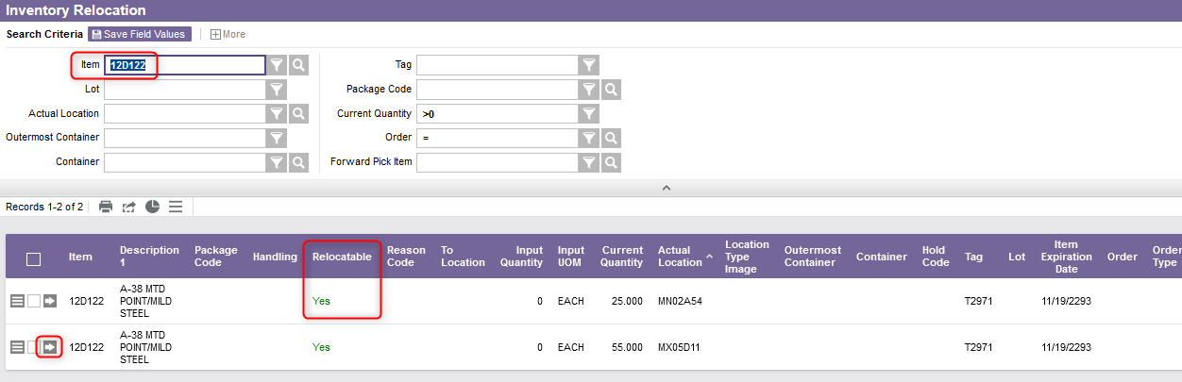
Inventory Relocation
From the new window, enter the item that you wish to relocate in the search criteria.
Select the View Record Details button of the desired record. Note: The Relocatable field must be set to Yes.

Slide 19
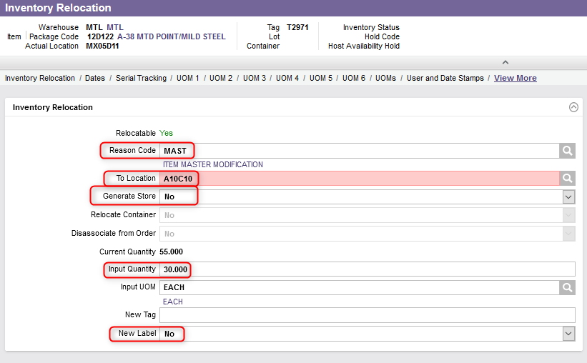
Inventory Relocation
From the new page, enter a reason code.
Specify a location in the To Location field.
Eventually, change the Generate Store field to Yes if you want to create a queued command which will be transmitted to a mobile device. Otherwise, select No.

Slide 20
Inventory Relocation
Enter the Input Quantity.
Change the New Label field to Yes if you want to print a new tag.
Click Submit.

Slide 21
Inventory Adjustments

Slide 22
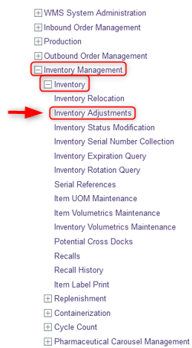
Inventory Adjustments
Inventory Adjustment is used to adjust the inventory levels to the actual quantity in a location for an item.
On a desktop computer, select the Inventory Management resource.
Under the Inventory Management resource, click on Inventory.
Under Inventory, select Inventory Adjustments.

Slide 23
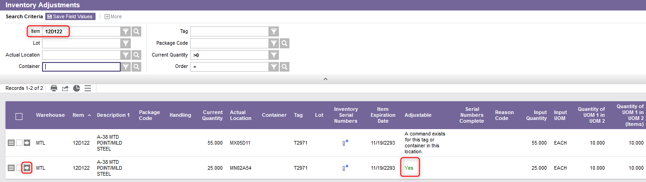
Inventory Adjustments
From the new window, enter the item that you wish to adjust in the search criteria.
Select the View Record Details button of the desired record. Note: The Adjustable field must be set to Yes.

Slide 24
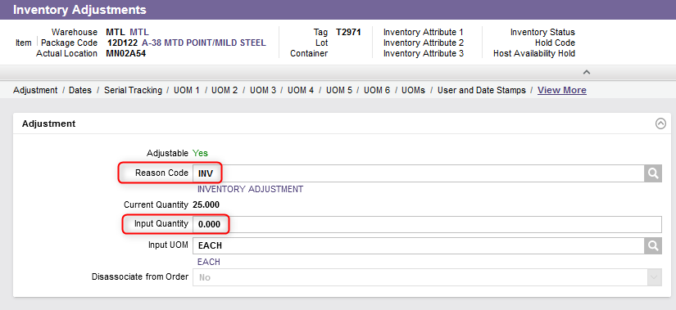
Inventory Adjustments
From the new page, enter the reason code “INV”.
Enter a new Quantity in the Input Quantity field. This can be 0.
Click Submit.

